Slide 1


ICEBERG QA / TEAM INTRODUCTION
AI QA experts
working with your team
Expanded coverage and hands-on coaching with tools like CARBON
CARBON by Testers.ai supports our work
Iceberg QA / AI QA expertise for your team
01
Notes:
OPENING, 45 seconds. Iceberg QA brings experienced human testing specialists into the team’s work. We use AI tools such as CARBON to expand the range of checks and preserve useful evidence. We can do the testing with you and teach your team how to use these tools. CARBON is the supporting harness built by Testers.ai. It is not the service provider or a replacement for business judgment.
Context: Iceberg QA services and coaching as described by Jason Arbon. CARBON capabilities and qualifications follow the supplied internal team deck. Official Iceberg QA artwork: /Users/jasonarbon/Desktop/cowork/ice/brand/lockup/lockup-768.png. https://icebergqa.com/ and https://testers.ai/carbon/

Slide 2
HOW WE HELP
Expert testing support
and team enablement
Experienced human QA specialists, amplified by AI.
More coverage, sooner
Skills your team can keep
Our AI QA experts investigate important journeys and edge cases with CARBON and complementary tools. Your team gets actionable findings and evidence.
Build your team’s skills through guided setup, live testing sessions and practical coaching. Learn to use tools like CARBON in your own workflow.
Hands-on support, coaching, or both
icebergqa.com
Iceberg QA / AI QA expertise for your team
02
Notes:
1 minute. Lead with the two service outcomes. Hands-on experts can rapidly expand coverage around important risks. Coaching helps the team repeat the work independently. Agree the product access and scope before testing. Do not promise a fixed amount of coverage, immediate availability, or a defect-free release. Tools and licenses depend on the engagement.
Context: Iceberg QA services and coaching as described by Jason Arbon. CARBON capabilities and qualifications follow the supplied internal team deck. Official Iceberg QA artwork: /Users/jasonarbon/Desktop/cowork/ice/brand/lockup/lockup-768.png. https://icebergqa.com/ and https://testers.ai/carbon/

Slide 3
PEOPLE AND TOOLS
Iceberg QA leads. CARBON supports the work.
Iceberg QA experts
The CARBON harness
Your product team
Test design, exploratory judgment and hands-on coaching
Risk-based workflows, specialist perspectives and saved evidence
Customer intent, priorities, acceptable risk and release ownership
CARBON works inside compatible coding agents such as Claude Code, Codex and Cursor.
Iceberg QA / AI QA expertise for your team
03
Notes:
90 seconds. Distinguish the service from the software. Iceberg QA experts guide the investigation and work with the team. CARBON provides repeatable workflows and saves evidence inside a compatible coding agent. The host supplies model and execution capabilities. The product team owns intent, acceptable risk and release decisions. This does not imply automatic access to any customer environment.
Context: Iceberg QA services and coaching as described by Jason Arbon. CARBON capabilities and qualifications follow the supplied internal team deck. Official Iceberg QA artwork: /Users/jasonarbon/Desktop/cowork/ice/brand/lockup/lockup-768.png. https://icebergqa.com/ and https://testers.ai/carbon/

Slide 4
WORKING WITH YOUR TEAM
Expert help across the delivery team
Developers
Testers / QA
Work from reproducible findings and verify focused fixes.
Pair with our experts to deepen exploration and test design.
Business analysts
Architecture / SA
Turn business intent and exceptions into testable expectations.
Prioritize cross-service risks and failure recovery.
Delivery / PC
CTO / leadership
Coordinate findings, owners and the evidence still needed.
Set boundaries and evaluate the value of AI-assisted QA.
Iceberg QA / AI QA expertise for your team
04
Notes:
1 minute. Iceberg QA complements the whole delivery team. Developers need reproducible evidence. QA can pair on deeper investigations. Business analysts help resolve ambiguous expectations. Architecture colleagues define system boundaries. Delivery and leadership coordinate ownership and evaluate value. Adjust SA and PC labels to match local job titles.
Context: Iceberg QA services and coaching as described by Jason Arbon. CARBON capabilities and qualifications follow the supplied internal team deck. Official Iceberg QA artwork: /Users/jasonarbon/Desktop/cowork/ice/brand/lockup/lockup-768.png. https://icebergqa.com/ and https://testers.ai/carbon/

Slide 5
OUR TESTING WORKFLOW
Experts direct a repeatable testing loop
01
02
03
04
05
Understand
Prioritize
Exercise
Explain
Continue
Intent, code and existing tests
Risk and important journeys
Checks and exploratory behavior
Evidence, findings and gaps
Retest or investigate the next risk
CARBON organizes the loop. Our experts challenge the checks and review the evidence.
Iceberg QA / AI QA expertise for your team
05
Notes:
90 seconds. Explain how experts use the workflow rather than running commands indiscriminately. Understand the product and existing tests, identify consequential risks, exercise the system and inspect the evidence. CARBON supports that loop. An expert decides whether the test oracle is useful and what to investigate next. Obtain authorization before writes or intrusive actions.
Context: Iceberg QA services and coaching as described by Jason Arbon. CARBON capabilities and qualifications follow the supplied internal team deck. Official Iceberg QA artwork: /Users/jasonarbon/Desktop/cowork/ice/brand/lockup/lockup-768.png. https://icebergqa.com/ and https://testers.ai/carbon/

Slide 6






CARBON’S AI TESTING SUB-AGENTS
Specialist perspectives, guided by our experts
AI
AI
AI
AI
AI
AI
Security
Privacy
Accessibility
Performance
Usability
AI-generated
code
AI perspectives extend exploration. Human experts review the findings.
Iceberg QA / AI QA expertise for your team
06
Notes:
1 minute. These icons represent virtual AI testing perspectives, not human staff members. Iceberg QA’s human experts direct their use and review the resulting evidence. Focused specialist commands and depth depend on the CARBON edition. Generated persona feedback alone does not prove a defect or replace real users.
Context: Iceberg QA services and coaching as described by Jason Arbon. CARBON capabilities and qualifications follow the supplied internal team deck. Official Iceberg QA artwork: /Users/jasonarbon/Desktop/cowork/ice/brand/lockup/lockup-768.png. https://icebergqa.com/ and https://testers.ai/carbon/

Slide 7
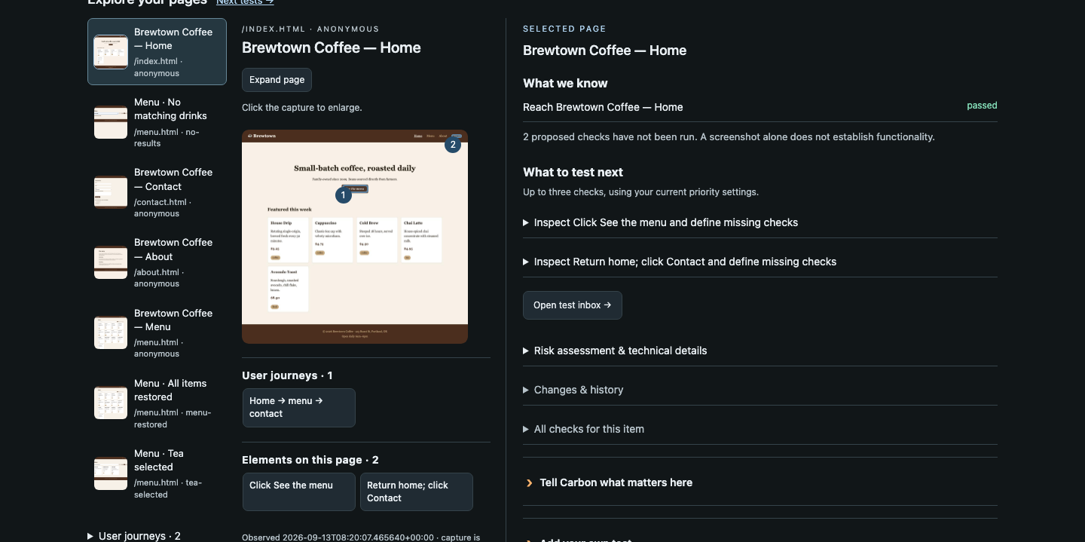
COVERAGE YOU CAN DISCUSS
A shared map for experts and your team
What was seen?
Pages, states and evidence
What comes next?
Untried checks and important risks
Existing demo capture. Advanced controls shown may require Pro.
Iceberg QA / AI QA expertise for your team
07
Notes:
1 minute. Use this existing CARBON demo capture to show how Iceberg QA and the customer team can discuss explored pages and untried checks. It is an illustrative Brewtown Coffee map, not a customer result or a new run. Advanced controls may require Pro. A screenshot is evidence of an observation, not proof that the whole journey works.
Context: Iceberg QA services and coaching as described by Jason Arbon. CARBON capabilities and qualifications follow the supplied internal team deck. Official Iceberg QA artwork: /Users/jasonarbon/Desktop/cowork/ice/brand/lockup/lockup-768.png. https://icebergqa.com/ and https://testers.ai/carbon/

Slide 8
TEAM ENABLEMENT
Coaching on your own product
Guided setup
Live working sessions
Configure the approved tools and agree safe testing boundaries.
Practice risk selection and exploratory testing with our experts.
Evidence review
Independent practice
Learn to reproduce findings, challenge results and verify repairs.
Apply the workflow to your next change with a repeatable approach.
Iceberg QA / AI QA expertise for your team
08
Notes:
1 minute. Training is most useful when the team works on a relevant, approved example. Iceberg QA can help with setup, pair on an investigation, and review the evidence together. The goal is for the team to understand test selection and interpretation, not simply memorize commands. Agree the format, scope and follow-up with the customer.
Context: Iceberg QA services and coaching as described by Jason Arbon. CARBON capabilities and qualifications follow the supplied internal team deck. Official Iceberg QA artwork: /Users/jasonarbon/Desktop/cowork/ice/brand/lockup/lockup-768.png. https://icebergqa.com/ and https://testers.ai/carbon/

Slide 9
GUIDED PRACTICE
A CARBON walkthrough with an expert
/carbon-demo
Create a disposable project and start a first run.
/carbon-issues
Investigate one multi-step flow in that demo.
/carbon-map
Show what was explored and what needs attention.
Our experts explain what to test, why it matters and how to interpret the result.
Iceberg QA / AI QA expertise for your team
09
Notes:
OPTIONAL DEMO, allow 3 minutes for a prepared run. Confirm the approved host and runtime setup in advance. Use synthetic data in the disposable demo. An expert explains one finding, the evidence and one next investigation. A saved report is a fallback, not a live result. A complete fresh run can take longer. Source command scope: the supplied CARBON Light reference slide.
Context: Iceberg QA services and coaching as described by Jason Arbon. CARBON capabilities and qualifications follow the supplied internal team deck. Official Iceberg QA artwork: /Users/jasonarbon/Desktop/cowork/ice/brand/lockup/lockup-768.png. https://icebergqa.com/ and https://testers.ai/carbon/

Slide 10
COMMAND EXAMPLES
CARBON commands
/carbon
/carbon-security
Run a bounded, broad assessment.
Investigate security weaknesses.
/carbon-auto
/carbon-issues
Run a bounded test, fix and retest loop.
Hunt reproducible bugs and state failures.
/carbon-accessibility
/carbon-map
Investigate accessibility barriers.
Visualize the current assessment.
/carbon-privacy
/carbon-confidence
Check how personal data is handled.
Assess readiness from scoped evidence.
Iceberg QA / AI QA expertise for your team
10
Notes:
COMMAND EXAMPLES. These eight commands illustrate the breadth of CARBON. Use /carbon for a broad assessment, /carbon-issues to hunt reproducible bugs, /carbon-accessibility to investigate barriers, /carbon-security for security weaknesses, /carbon-privacy for personal-data handling, /carbon-map to visualize an assessment, /carbon-auto for a bounded test-fix-retest loop, and /carbon-confidence to assess readiness from scoped evidence. Select commands according to the product and engagement. Obtain authorization before repairs or intrusive testing.
Context: Iceberg QA services and coaching as described by Jason Arbon. CARBON capabilities and qualifications follow the supplied internal team deck. Official Iceberg QA artwork: /Users/jasonarbon/Desktop/cowork/ice/brand/lockup/lockup-768.png. https://icebergqa.com/ and https://testers.ai/carbon/

Slide 11
WORK WITH ICEBERG QA
Where would expert help matter most?
Which journeys need deeper coverage?
Where would hands-on support help now?
What should your team learn to do themselves?
Testing support and team training
https://icebergqa.com/
Jason Arbon
Philip Lew
jason.arbon@icebergqa.com
philip.lew@icebergqa.com
Iceberg QA / AI QA expertise for your team
11
Notes:
CLOSE. Invite a discussion about the most consequential coverage gaps and the skills the team wants to build. Iceberg QA can provide hands-on testing support, practical coaching, or a combination. Agree a target, access and scope before work begins. The customer retains business and release ownership. Contact Jason Arbon at jason.arbon@icebergqa.com or Philip Lew at philip.lew@icebergqa.com. Service information: https://icebergqa.com/.
Context: Iceberg QA services and coaching as described by Jason Arbon. CARBON capabilities and qualifications follow the supplied internal team deck. Official Iceberg QA artwork: /Users/jasonarbon/Desktop/cowork/ice/brand/lockup/lockup-768.png. https://icebergqa.com/ and https://testers.ai/carbon/

