Slide 1


CARBON / TEAM INTRODUCTION
AI testing inside your
development workflow
An AI test harness with specialist sub-agents for your coding agent
Built by Testers.ai
CARBON / Built by Testers.ai
01
Notes:
OPENING. CARBON brings a repeatable AI testing workflow and specialist perspectives into compatible coding agents. Testers.ai builds the harness. The team retains product intent, risk decisions and release ownership. This concise presentation covers the workflow, commands and optional expert help.
Sources: CARBON and Iceberg QA supplied presentation materials. https://testers.ai/carbon/ and https://icebergqa.com/. Existing demo screenshots are illustrative captures, not new test results.

Slide 2
INSIDE YOUR CODING AGENT
CARBON adds a testing harness to your agent
Your coding agent
The CARBON harness
Your product team
Model, source context, browser and development tools
Risk-based workflows, specialist perspectives and saved evidence
Customer intent, priorities, acceptable risk and release ownership
CARBON works inside compatible coding agents such as Claude Code, Codex and Cursor.
CARBON / Built by Testers.ai
02
Notes:
The coding agent supplies the model and execution environment. CARBON adds risk-based workflows, specialist perspectives and durable evidence. Your team defines acceptable behavior and owns release decisions. Compatible host, runtime and permissions are required. A local harness can still send context to the host model provider.
Sources: CARBON and Iceberg QA supplied presentation materials. https://testers.ai/carbon/ and https://icebergqa.com/. Existing demo screenshots are illustrative captures, not new test results.

Slide 3
FOR THE WHOLE DELIVERY TEAM
Testing context for every role
Developers
Testers / QA
Work from reproducible findings and verify focused fixes.
Broaden exploration and challenge weak test checks.
Business analysts
Architecture / SA
Turn business intent and exceptions into testable expectations.
Prioritize cross-service risks and failure recovery.
Delivery / PC
CTO / leadership
Coordinate findings, owners and the evidence still needed.
Set boundaries and evaluate the value of AI-assisted QA.
CARBON / Built by Testers.ai
03
Notes:
Developers use reproducible findings and retest fixes. Testers steer exploration. Business analysts clarify ambiguous expectations. Architecture colleagues examine service interactions. Delivery colleagues coordinate owners and blockers. Leaders evaluate risk and adoption value. Adjust SA and PC labels to local role names.
Sources: CARBON and Iceberg QA supplied presentation materials. https://testers.ai/carbon/ and https://icebergqa.com/. Existing demo screenshots are illustrative captures, not new test results.

Slide 4
ONE COMMAND
/carbon starts the testing loop
01
02
03
04
05
Understand
Prioritize
Exercise
Explain
Continue
Intent, code and existing tests
Risk and important journeys
Checks and exploratory behavior
Evidence, findings and gaps
Retest or investigate the next risk
A visible plan and report keep the investigation understandable.
CARBON / Built by Testers.ai
04
Notes:
CARBON examines intent, code and existing tests, prioritizes risks, exercises relevant behavior and records evidence. It can create or adapt checks to the available tools. Continue with the next meaningful gap or verify a repair. Repairs and intrusive actions require appropriate authorization. Confidence summarizes the investigated scope, not proof that the entire product is correct.
Sources: CARBON and Iceberg QA supplied presentation materials. https://testers.ai/carbon/ and https://icebergqa.com/. Existing demo screenshots are illustrative captures, not new test results.

Slide 5






CARBON’S AI TESTING SUB-AGENTS
AI sub-agents examine different risks
AI
AI
AI
AI
AI
AI
Security
Privacy
Accessibility
Performance
Usability
AI-generated
code
CARBON coordinates specialist perspectives. Your team steers the priorities.
CARBON / Built by Testers.ai
05
Notes:
These are AI testing sub-agents, not human staff profiles. Their perspectives cover security, privacy, accessibility, performance, usability and issues associated with AI-generated code. Findings still need reproducible evidence. Available tools and configuration affect what the agent can verify.
Sources: CARBON and Iceberg QA supplied presentation materials. https://testers.ai/carbon/ and https://icebergqa.com/. Existing demo screenshots are illustrative captures, not new test results.

Slide 6
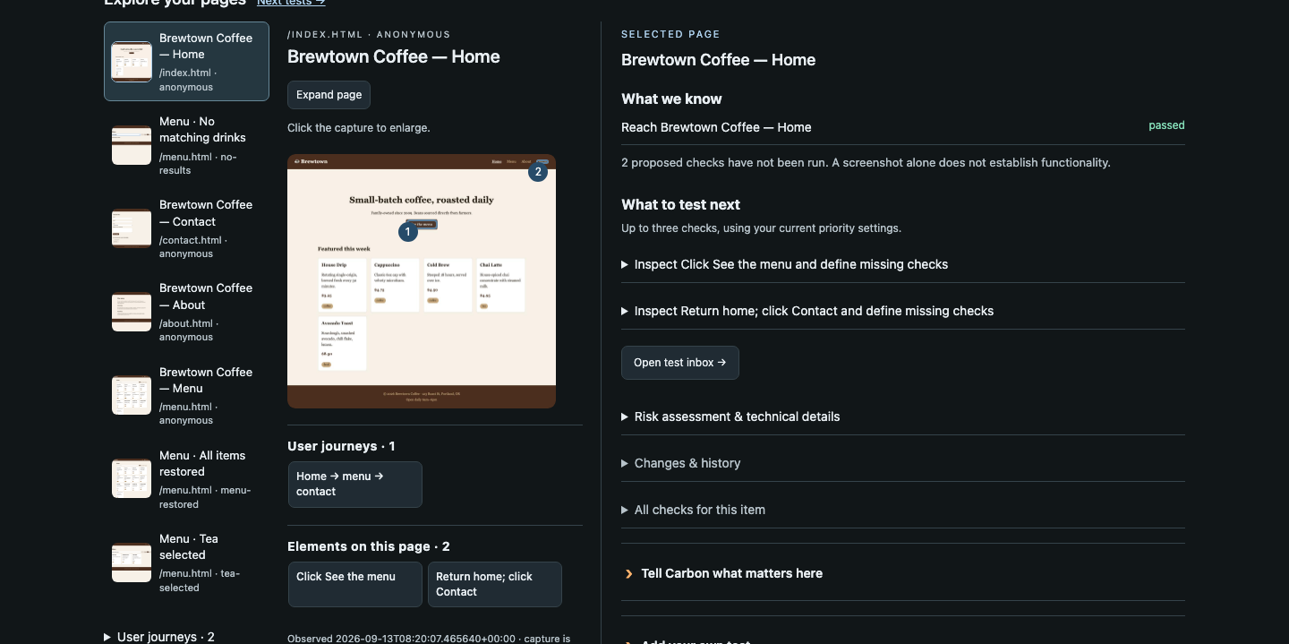
COVERAGE YOU CAN DISCUSS
A shared map of testing coverage
What was seen?
Pages, states and evidence
What comes next?
Untried checks and important risks
Existing demo capture. Available controls depend on your installation.
CARBON / Built by Testers.ai
06
Notes:
This is an existing Brewtown Coffee demo capture. Explain the explored pages, screenshots, observed results and proposed checks. Distinguish observed evidence from untested suggestions. A screenshot is not proof that a complete user journey passes. Controls depend on the installed capabilities.
Sources: CARBON and Iceberg QA supplied presentation materials. https://testers.ai/carbon/ and https://icebergqa.com/. Existing demo screenshots are illustrative captures, not new test results.

Slide 7
A SHORT WALKTHROUGH
Try CARBON on a disposable project
/carbon-demo
Create a disposable project and start a first run.
/carbon-issues
Investigate one multi-step flow in that demo.
/carbon-map
Show what was explored and what needs attention.
Start with a demo, investigate a journey, then explore the evidence.
CARBON / Built by Testers.ai
07
Notes:
OPTIONAL DEMO. Prepare an approved host and disposable synthetic project. Run /carbon-demo, follow with a focused /carbon-issues investigation and use /carbon-map to explain what was explored. Show one reproducible finding and a useful next check. Keep a saved result as a clearly labeled fallback.
Sources: CARBON and Iceberg QA supplied presentation materials. https://testers.ai/carbon/ and https://icebergqa.com/. Existing demo screenshots are illustrative captures, not new test results.

Slide 8
COMMAND EXAMPLES
CARBON commands
/carbon
/carbon-security
Run a bounded, broad assessment.
Investigate security weaknesses.
/carbon-auto
/carbon-issues
Run a bounded test, fix and retest loop.
Hunt reproducible bugs and state failures.
/carbon-accessibility
/carbon-map
Investigate accessibility barriers.
Visualize the current assessment.
/carbon-privacy
/carbon-confidence
Check how personal data is handled.
Assess readiness from scoped evidence.
CARBON / Built by Testers.ai
08
Notes:
Eight examples show the breadth of CARBON without separating commercial editions. /carbon performs a broad assessment. Focused security, privacy and accessibility commands investigate their domains. /carbon-issues hunts bugs, /carbon-auto supports a bounded authorized test-fix-retest loop, /carbon-map visualizes evidence and /carbon-confidence evaluates scoped readiness.
Sources: CARBON and Iceberg QA supplied presentation materials. https://testers.ai/carbon/ and https://icebergqa.com/. Existing demo screenshots are illustrative captures, not new test results.

Slide 9
IN YOUR DAILY WORKFLOW
A repeatable routine for each change
Scope the change
Investigate the risk
Give CARBON the relevant code, intent and existing tests.
Exercise important journeys, state changes and failure recovery.
Review the evidence
Keep what you learn
Reproduce findings, inspect the gaps and verify authorized repairs.
Save useful checks and context for the next investigation.
CARBON / Built by Testers.ai
09
Notes:
Use CARBON on a specific change with clear scope. Bring existing tests and intent into the investigation, exercise relevant risks, review evidence and retain useful checks. Durable context helps future work, but stale evidence needs revalidation after changes. The team authorizes repairs and owns decisions.
Sources: CARBON and Iceberg QA supplied presentation materials. https://testers.ai/carbon/ and https://icebergqa.com/. Existing demo screenshots are illustrative captures, not new test results.

Slide 10

OPTIONAL EXPERT HELP
Iceberg QA testing support
and team training
Experienced human QA specialists, amplified by AI.
More coverage, sooner
Skills your team can keep
Our AI QA experts investigate important journeys and edge cases with CARBON and complementary tools. Your team gets actionable findings and evidence.
Build your team’s skills through guided setup, live testing sessions and practical coaching. Learn to use tools like CARBON in your own workflow.
Use CARBON yourself, or bring in expert help
icebergqa.com
CARBON / Built by Testers.ai
10
Notes:
Iceberg QA is an optional services and training partner. Its human AI QA experts can broaden coverage with CARBON and complementary tools, and coach the team through setup, live investigations and evidence review. Agree service scope and tool access separately. CARBON does not require an Iceberg QA engagement.
Sources: CARBON and Iceberg QA supplied presentation materials. https://testers.ai/carbon/ and https://icebergqa.com/. Existing demo screenshots are illustrative captures, not new test results.

Slide 11
GET STARTED WITH CARBON
Where could CARBON help your team first?
Which journey needs more testing?
What would you like CARBON to investigate?
Would expert support help you get started?
Install CARBON. For expert support, contact Iceberg QA below.
https://testers.ai/carbon/
Jason Arbon
Philip Lew
jason.arbon@icebergqa.com
philip.lew@icebergqa.com
CARBON / Built by Testers.ai
11
Notes:
Install information is at https://testers.ai/carbon/. Pick an important journey and an approved target for the first investigation. Optional Iceberg QA testing and training contacts: Jason Arbon at jason.arbon@icebergqa.com and Philip Lew at philip.lew@icebergqa.com.
Sources: CARBON and Iceberg QA supplied presentation materials. https://testers.ai/carbon/ and https://icebergqa.com/. Existing demo screenshots are illustrative captures, not new test results.

